Slide 1
#BlaastMeet Tweet It!
Notes:
Younger
Experienced managers
Skype founding engineers
Nokia SVP

Slide 2
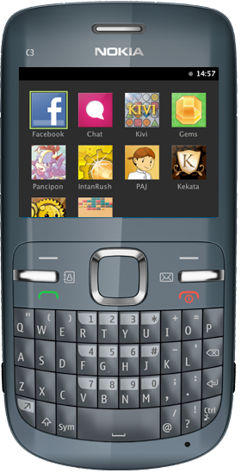


Architecture
Backend – Server – Cloud
World Wide
Client

Slide 3
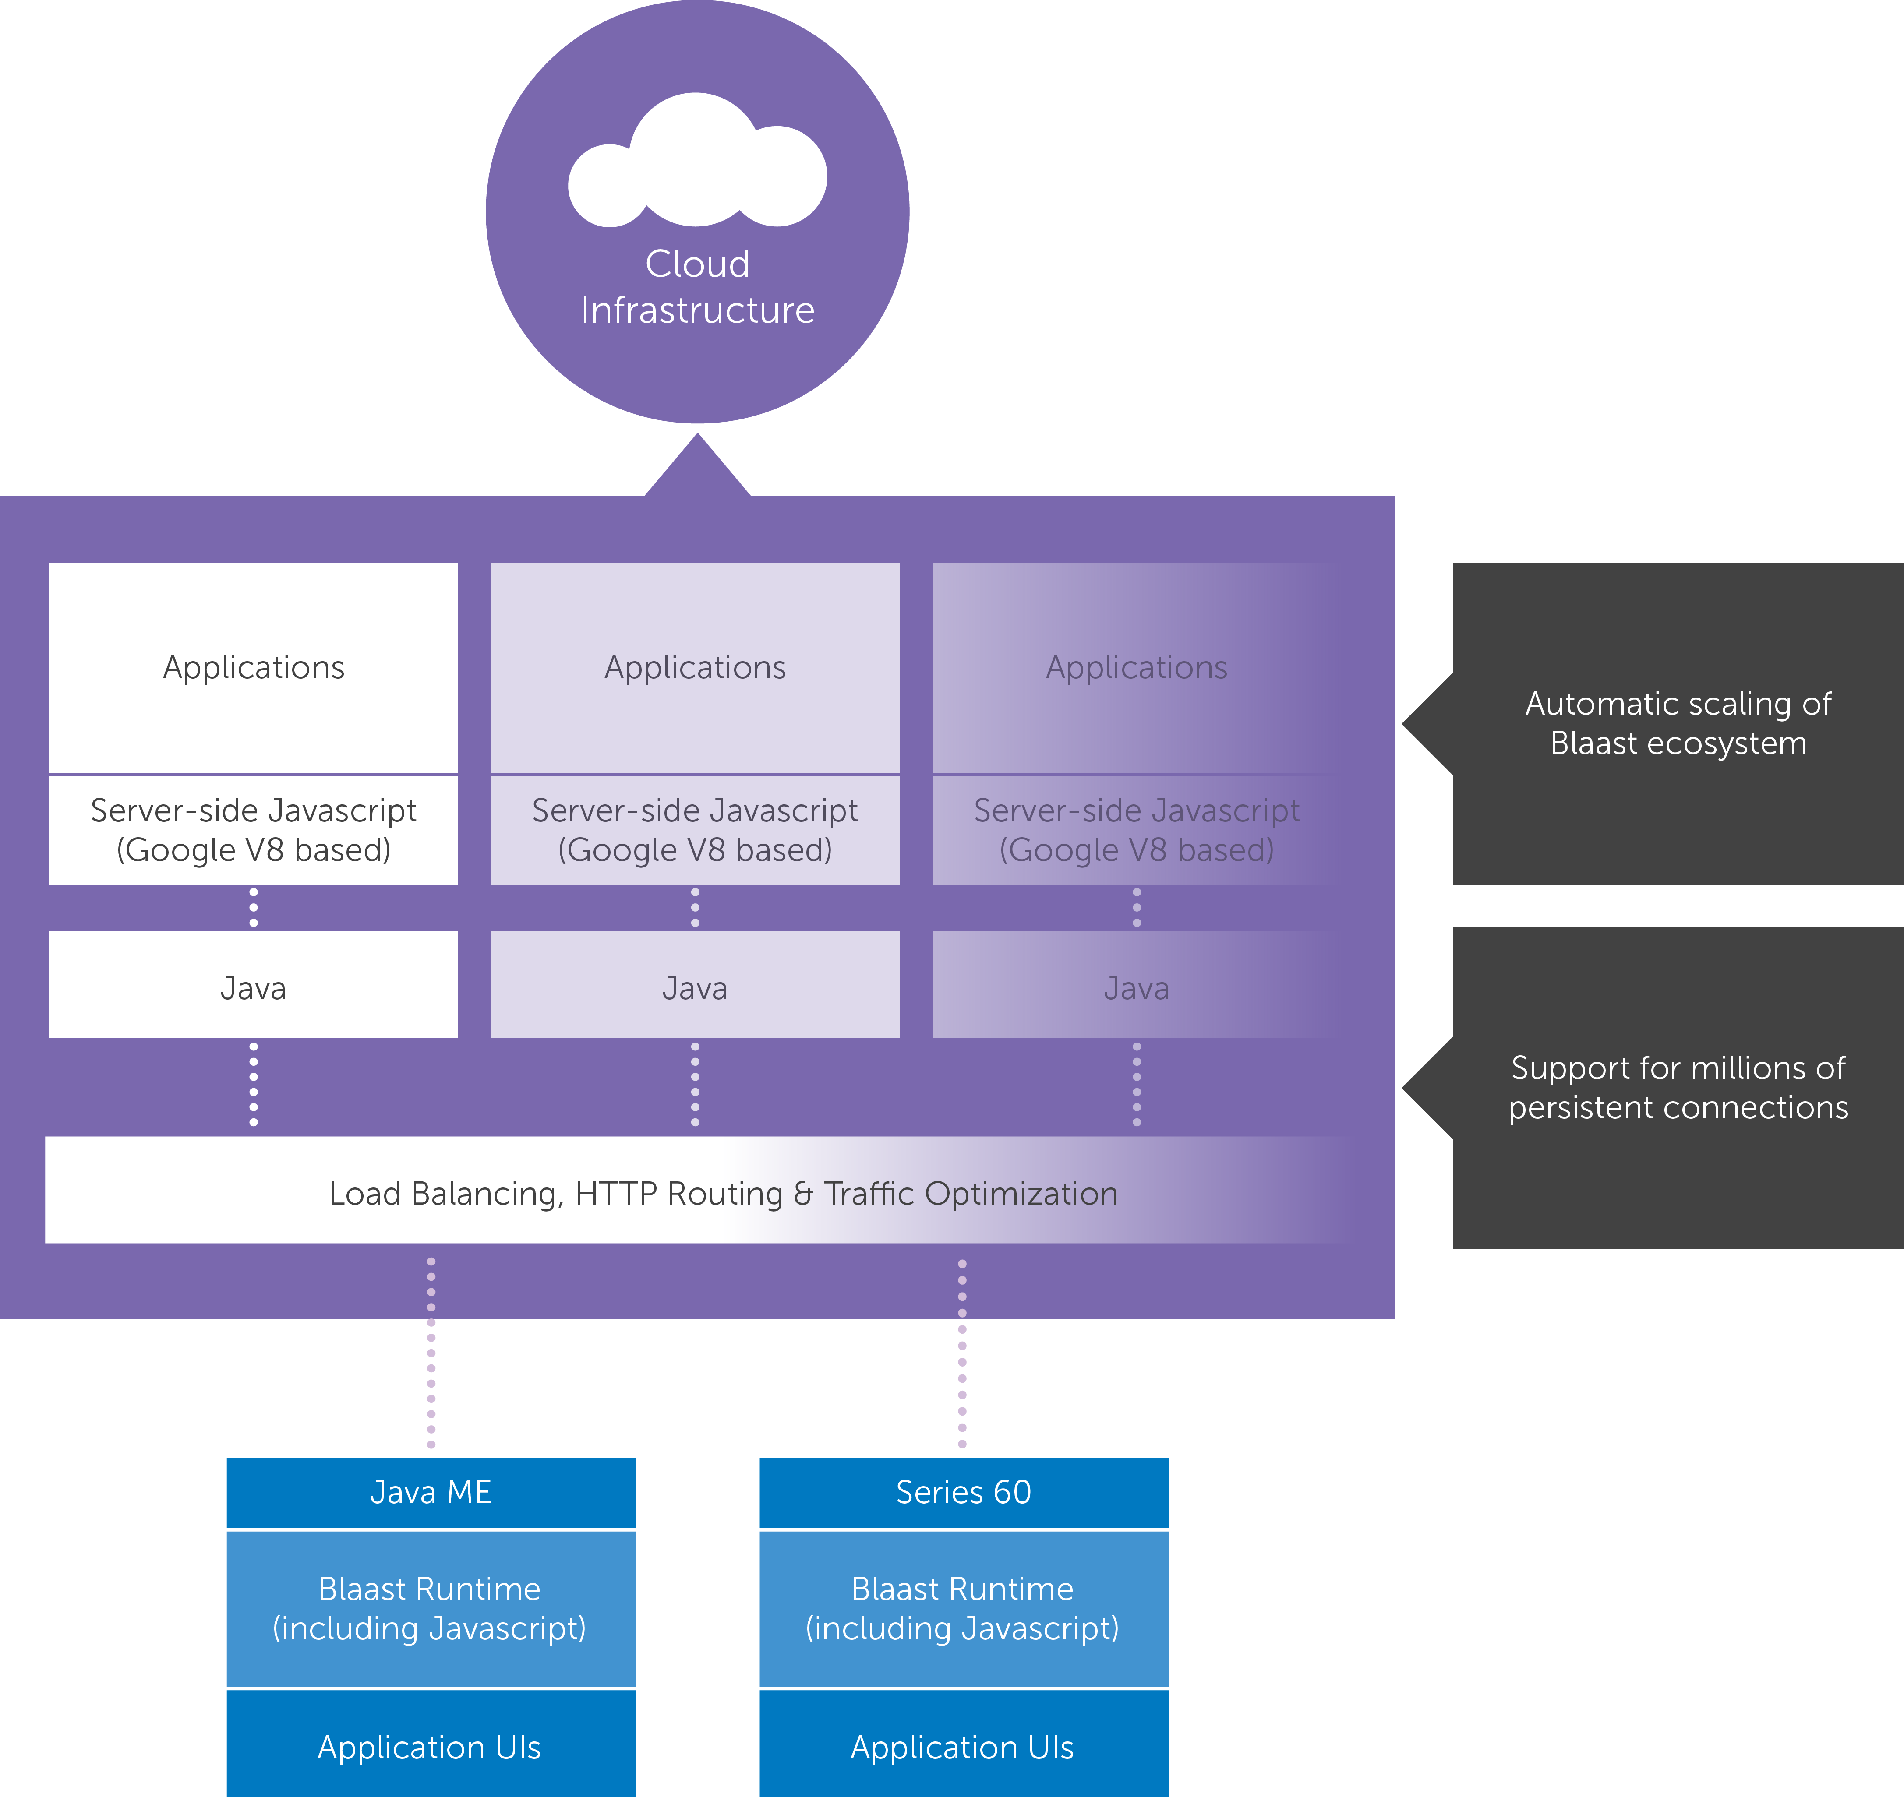
Architecture
Cloud controlled end-to-end platform for supporting millions of users
Apps run in node.js containers in the cloud
UI runs in the device with full offline capability
Easiest app development – write once, run on any device
Anti-fragmentation
Bandwidth optimization

Slide 4
Rocket SDK

Slide 5
IDE / Editor ?

Slide 6
Use your lovely Editor!

Slide 7


Slide 8

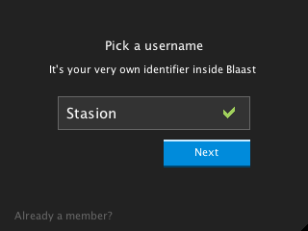
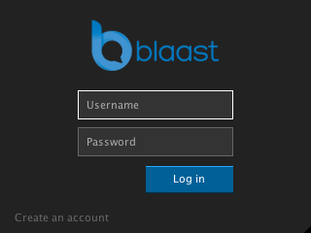
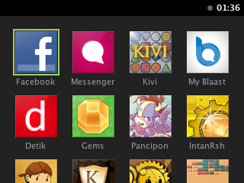
UI

Slide 9
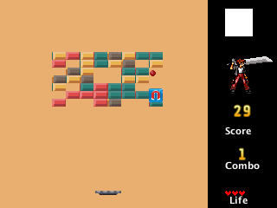

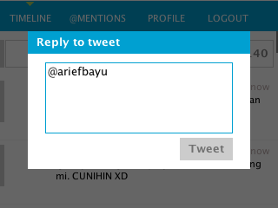
UI

Slide 10
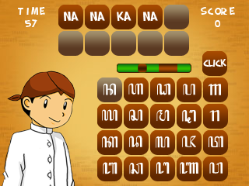
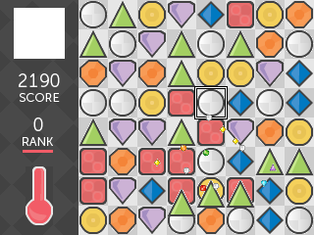
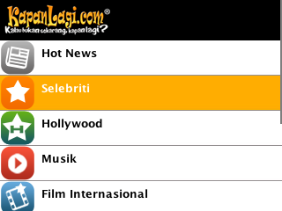
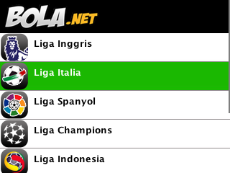
UI

Slide 11
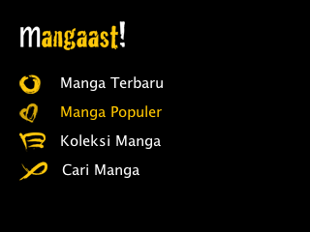
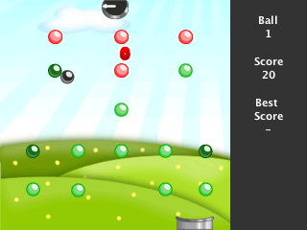

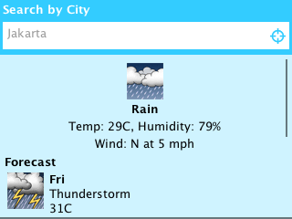
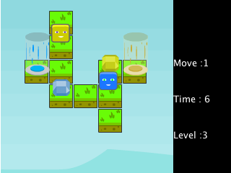
UI

Slide 12
Source Files
Project-dir
controller/ => javascript untuk setiap page
res/ => semua resources aplikasi (gambar, music, etc)
views/ => definisi setiap page, berupa .json
backend.js => berisi kode2 server
bootstrap.js => kode yang dijalankan pertama kali
metadata.json => detail informasi aplikasi
Satu controller HARUS ada 1 pasangan views:
-controller/main.js -views/main.json

Slide 13
Controller files
Handle client methods:
var _ = require('common/util');
_.extend(exports, {
':load': function() { console.log('View was loaded'); },
':resized': function(width, height) {
console.log('View was resized to ' + width + 'x' + height);
},
':keydown': function(key) { console.log('Key down: '+ key); },
':keyup': function(key) { console.log('Key up: ' + key); },
':keypress': function(key) { console.log('Key press: ' + key); },
':active': function() { console.log('View is active'); },
':inactive': function() { console.log('View is inactive'); }
});

Slide 14
Layout and control

Slide 15
Layout & Control
Linear Layout
var LinearLayout = require('ui').LinearLayout; new LinearLayout(
{
style:{ orientation: orientationDefinition }
}
);
orientationDefinition: horizontal // vertical
Class turunan: * Hlayout => LinearLayout.orientation = “vertical”
* Vlayout => LinearLayout.orientation = “horizontal”

Slide 16
Layout & Control
Cell Layout
var CellLayout = require('ui').CellLayout; new CellLayout(
{
columns: columnCount,
cellSize:
{
width: theWidth,
height: theHeight
}
}
}
);

Slide 17
Layout & Control
Panel Layout
var Panels = require('ui/panels').Panels;
var p = new Panels();
p.add('first', 'firstView');
p.add('second', 'secondView');

Slide 18
Layout & Control
TextView
var TextView = require(‘ui’).TextView; new TextView(); new TextView(
{
label: theLabel
}
);

Slide 19
Layout & Control
TextInput
var InputBox = require(‘ui’).InputBox; new InputBox(); new InputBox(
{
constraint: theConstraint,
label: theLabel,
'multi-line': flag
}
);
Constraint: normal // password ‘multi-line’: true // false

Slide 20
Layout & Control
ImageView
var ImageView = require('ui').ImageView;
var ui = require('ui');
var ImageView = ui.ImageView;
new ImageView();
new ImageView({
src: srcUrl,
load: loadStrategy,
retain: shouldRetain
});
Load: direct // lazy retain: true // false
src => for images in res/ resource => for images from outside. Need companion app.setResourceHandler() on backend.js

Slide 21
Layout & Control
SceneView
var SceneView = require(‘ui’).SceneView; var scene = new SceneView(); scene.setLayers(); sceneView.defineSpritesheet('anim',
app.imageURL('anim.png'), 25, 25); scene.add( {
sprite: 'anim',
x: 100, y: 100,
layer: 0, frame: 0
} );

Slide 22
Client Storage
Initialize Storage Variable: var storage = app.storage('storage-name');
Get Stored Data: var data = storage.get('object-name');
Set Stored Data: storage.set('object-name', daa);

